Slide 1
Workshop 3: Indicators and the Backtester
March 24, 2023

Slide 2
Today’s Agenda:
Section 1 - Putting you into teams!
Section 2 - Workshop
Recap of last week
Pulling from API
qfinuwa package
Implementing Indicators

Slide 3

Optiver event next week!

Slide 4
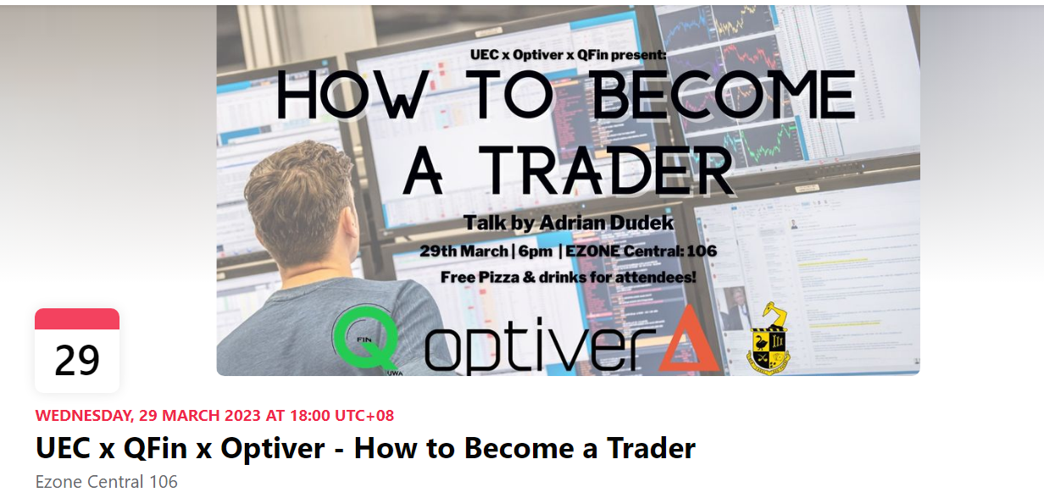
Another Optiver event next week!

Slide 5
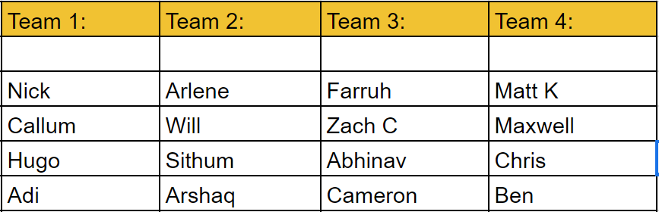
TRADING TEAMS

Slide 6
Installing VSCode and Python
Install VSCode and Python 10 if you haven’t:
https://code.visualstudio.com/
https://www.python.org/downloads/
Then open up your cmd, and type in:
pip install lxml matplotlib numpy pandas

